Slide 1
Birth – Death Processes
Shovan Bhowmik
Lecturer
Dept. of CSE, BAiust

Slide 2
Introduction
Number of people present in any queuing system at time t to be the state of the queuing systems at time t.
For t₀ the state of the system will equal the number of people initially present in the system.
The quantity P_{ij}(t) which is defined as the probability that j people will be present in the queuing system at time t, given that at time 0, i people are present.
P_{ij}(t) is analogous to the n-step transition probability P_{ij}(n).
We call π_{j} the steady state, or equilibrium probability, of state j.

Slide 3
Introduction(Cont..)
If t is small, then we would expect that P_{50,1}(t) and P_{1,1}(t) would differ substantially.
If steady-state probabilities exist, then for large t, both P_{50,1}(t) and P_{1,1}(t) will be near π₁ .
The behavior of P_{ij}(t) before the steady state is reached is called the transient behavior of the queuing system.
A birth-death process is a continuous time stochastic process for which the system’s state at any time is a nonnegative integer.

Slide 4
Laws of motion for birth-death
Law 1:
With probability λ_{j}Δt + o(Δt), a birth occurs between time t and time t+Δt.
A birth increases the system state by 1, to j+1.
The variable λ_{j} is called the birth rate in state j.
In most queuing systems, a birth is simply an arrival.
Law 2:
With probability µ_{j}Δt + o(Δt), a death occurs between time t and time t + Δt.
A death decreases the system state by 1, to j-1.
The variable µ_{j} is the death rate in state j.
In most queuing systems, a death is a service completion.
Note that, µ₀ = 0 must hold, or a negative state could occur.

Slide 5
Laws of motion for birth-death(Cont..)
Law 3:
Births and deaths are independent of each other.
Notes:
Laws 1–3 can be used to show that the probability that more than one event (birth or death) occurs between t and t+Δt is o(Δt).
Birth–death process is completely specified by knowledge of the birth rates λ_{j} and the death rates µ_{j}.

Slide 6
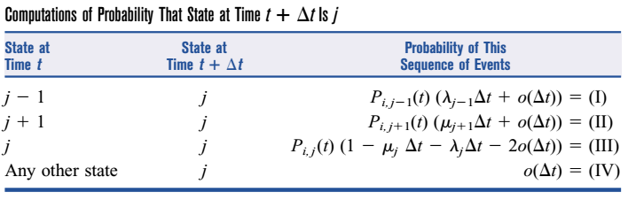
Birth – Death Process
λ₀
λ₁
λ₂
λ_{j-2}
λ_{j-1}
λ_{j}
λ_{j+1}
0
1
2
….
j-1
0
j
j+1
….
μ₁
μ₂
μ₃
μ_{j-1}
μ_{j}
μ_{j+1}

Slide 7
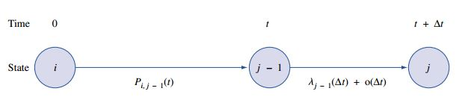
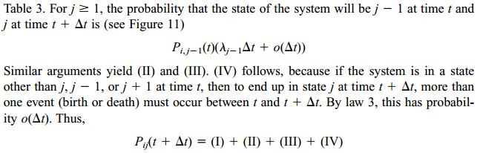
Derivation of Steady – State Probabilities for Birth – Death Process
We now show how the π_{j}’s may be determined for an arbitrary birth-death process.
The key role is to relate (for small Δt) P_{ij}(t+Δt) to P_{ij}(t).
For j ≥ 1, the four ways are shown in the previous table.

Slide 8
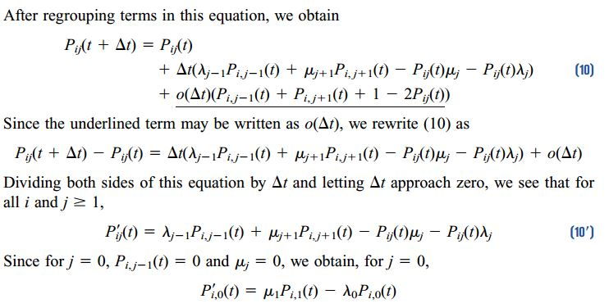
Derivation of Steady – State Probabilities for Birth – Death Process(Cont..)

Slide 9


Derivation of Steady – State Probabilities for Birth – Death Process(Cont..)
- this is an infinite system of differential equation.
In reality, this system equations are extremely difficult to solve.
We can use (10’) to obtain the steady-state probabilities π_{j} (j = 0, 1, 2, . . .).
As with Markov chains, we define the steady-state probability π_{j} to be
Then for large t and any initial state i, P_{ij}(t) will not change very much and may be thought of as a constant.
Thus, in the steady state (t large), P_{ij}’(t) = 0.

Slide 10
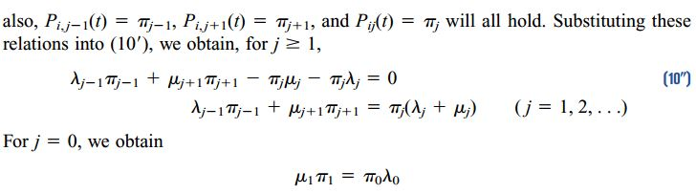
Derivation of Steady – State Probabilities for Birth – Death Process(Cont..)
In the steady state:
At any time t that we observe a birth–death process, it must be true that for each state j, the number of times we have entered state j differs by at most 1 from the number of times we have left state j.

Slide 11
Steady – State Probabilities for Birth – Death Process
The above equations are often called the flow balance equations, or conservation of flow equations, for a birth-death process.
= Expected no. of entrances into state j
= Expected no. of departures from state j

Slide 12
Solution of Birth – Death Flow Balance Equation
λ₀
λ₁
λ₂
λ_{j-2}
λ_{j-1}
λ_{j}
λ_{j+1}
0
1
2
….
j-1
0
j
j+1
….
μ₁
μ₂
μ₃
μ_{j-1}
μ_{j}
μ_{j+1}

Slide 13
Solution of Birth – Death Flow Balance Equation(Cont..)

Slide 14
Solution of Birth – Death Flow Balance Equation(Cont..)
For steady state, the requirement is:
If is finite, we can solve for π₀:
It can be shown that if is infinite, then no steady-state distribution exists.
The most common reason for a steady-state failing to exist is that the arrival rate is at least as large as the maximum rate at which customers can be served.

Slide 15
Equations to be remembered
λ₀
λ₁
λ₂
λ_{j-2}
λ_{j-1}
λ_{j}
λ_{j+1}
0
1
2
….
j-1
0
j
j+1
….
μ₁
μ₂
μ₃
μ_{j-1}
μ_{j}
μ_{j+1}

Slide 16
References
Operations Research Applications and Algorithms(4th Edition) – Wayne L. Winston

Slide 17


